Slide 1
Developer's
Dash
CURRENT SITUATION IS THE RIGHT APPROACH FOR INNOVATION

Slide 2
What Are we Building?

Slide 3
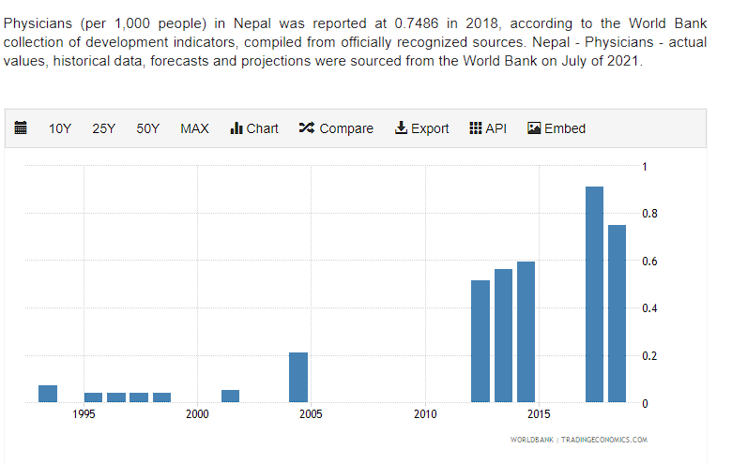

Slide 5
01
Non-Profit
BUSINESS MODEL
02
Revenue will be generated through Ads
03
Target the Local Market for Ads and Promotion

Slide 6
01
HTML(Frontend)
02
CSS(Frontend)
Technology Used
03
JavaScript(Frontend)
04
Django(Backend)

Slide 7

FUTURE PLAN
To be Better and Keep Growing and reach every community and its people around the country.

Slide 8

THANK YOU

